Slide 1



MEDICINE INVENTORY MANAGEMENT SYSTEM
Supervisor by:
Dr. Mohamed Elsayeh
TA. Habiba Mohamed Ibrahim
Team Members:
Farah Sameh Amin ID:231000120
Sandy Ibrahim Tawadrous ID:231000813
Rodaina Mohamed Abdelaziz ID: 231000739
Mariam Ezz Eldin ID:231000933

Slide 2

Objective:
Build a relational database to manage medicines, prescriptions, and billing.
Importance:
Prevents prescribing errors & stockouts
Ensures billing accuracy
Enhances patient safety
Real-world application in hospitals and pharmacies.
farah sameh

Slide 3



KEY FEATURES
Manage:
Doctors & Patients
Diseases & Medicines
Prescriptions & Bills
Advanced functionalities:
Automatic billing (Triggers)
Complex queries (CTEs & Views)
farah sameh

Slide 4

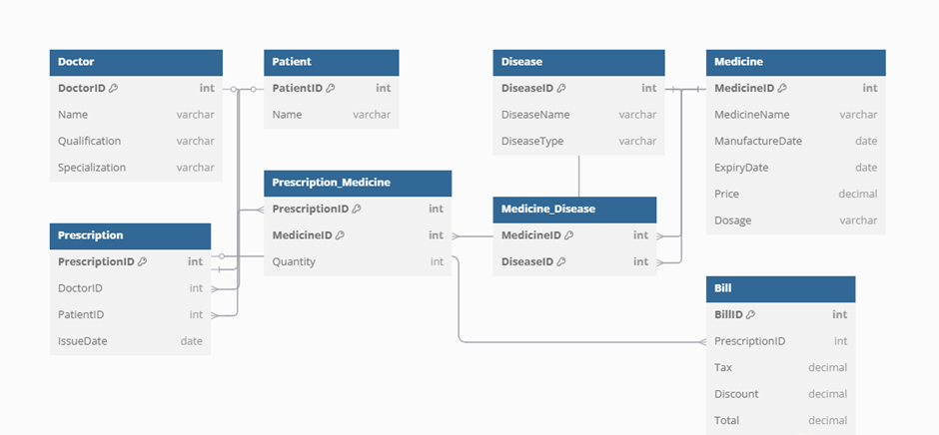

ER DIAGRAM
farah sameh

Slide 5
ENTITY DESCRIPTIONS:
Entity
Medical condition to treat
Description
Disease
Final amount after prescription
Bill
Doctor
Issues prescriptions
Drug for treatment
Medicine
Prescription_Medicine & Medicine_Disease
Junction Tables
Receives treatment
Issued by doctor for patient
Patient
Prescription
farah sameh

Slide 6

RELATIONSHIP TYPES
One-to-Many: Doctor → Prescription
One-to-Many: Patient → Prescription
Many-to-Many:
Prescription ↔ Medicine
Medicine ↔ Disease
One-to-One: Prescription ↔ Bill
farah sameh

Slide 7

Relational Schema
Tables:
Doctor
Patient
Disease
Medicine
Prescription
Bill
Prescription_Medicine
Medicine_Disease
farah sameh

Slide 8


Database created using CREATE DATABASE hospital_db;
Stores doctor info doctor_id INT PRIMARY KEY, doctor_name VARCHAR(100)
Stores diseases and types CHECK (disease_type IN (...)
Includes name, price, expiry medicine_name VARCHAR(100), price DECIMAL(10,2)
TABLES DESIGN SUMMARY
Doctor Table
Disease Table
Medicine Table
rodaina abdelaziz

Slide 9
Prescription Table
Links doctor and patient FOREIGN KEY (doctor_id) REFERENCES Doctor(doctor_id)
Handles many-to-many + quantity, PRIMARY KEY (prescription_id, medicine_id)
Connects medicines and diseases, FOREIGN KEY (disease_id) REFERENCES Disease(disease_id)
Stores tax, discount, total total DECIMAL(10,2)
TABLES DESIGN SUMMARY
Prescription_Medicine
Medicine_Disease
Bill Table
rodaina abdelaziz

Slide 10
SQL queries
Query 1 – List Doctors Specialized in Heart Diseases
Query 2 – List Diseases of Type “Deficiency”
Query 3 – Most Sold Medicine in 2023
SELECT M.MedicineName, SUM(PM.Quantity) AS TotalSold
FROM Prescription P
JOIN Prescription_Medicine PM ON P.PrescriptionID = PM.PrescriptionID
JOIN Medicine M ON PM.MedicineID = M.MedicineID
WHERE YEAR(P.IssueDate) = 2023
GROUP BY M.MedicineID
ORDER BY TotalSold DESC
LIMIT 1;
SELECT Name
FROM Doctor
WHERE Specialization LIKE '% heart%
SELECT DiseaseName
FROM Disease
WHERE DiseaseType = 'deficiency';
sandy ibrahim

Slide 11

TRIGGERS
Calculate Bill
Calculate Bill Total
Goal
After new prescription
Adds bill with 14% tax
After adding medicine to prescription
Updates total in bill
Auto billing
Reduce errors
mariam EZZ

Slide 12

THANK YOU!

